Slide 1

Data Transformation
Notes:
Data transformation is the process of converting data or information from one format to another, usually from the format of a source system into the a more suitable format for modelling. This presentation introduces few common data transformations and discus their implementation in R.

Slide 2
Data Transformation
Various transformations can be applied to data to make it more suitable for the modelling.
The following transformations are considered in this presentation:
Normalization (numeric variables)
Logarithmic Transformation (numeric variables)
Dummy Variables (categorical variables)
Notes:
In this presentation, the following data transformations are discussed. Normalization, logarithmic transformation and creating dummy variables. Normalization and logarithmic transformations are more suitable for numerical variables while dummy variables can be created from categorical attributes.
These transformations are very common and are regularly applied in analytics projects.

Slide 3
Data Transformation
Various transformations can be applied to data to make it more suitable for the modelling.
The following transformations are considered in this presentation:
Normalization (numeric variables)
Logarithmic Transformation (numeric variables)
Dummy Variables (categorical variables)
Notes:
There are many reasons for transformation. For example, a transformed scale may be as natural as the original scale and more convenient for a specific purpose such as interpreting percentiles.
In this presentation, the following data transformations are discussed. Normalization, logarithmic transformation and creating dummy variables. Normalization and logarithmic transformations are more suitable for numerical variables while dummy variables can be created from categorical attributes.
These transformations are very common and are regularly applied in analytics projects.

Slide 4
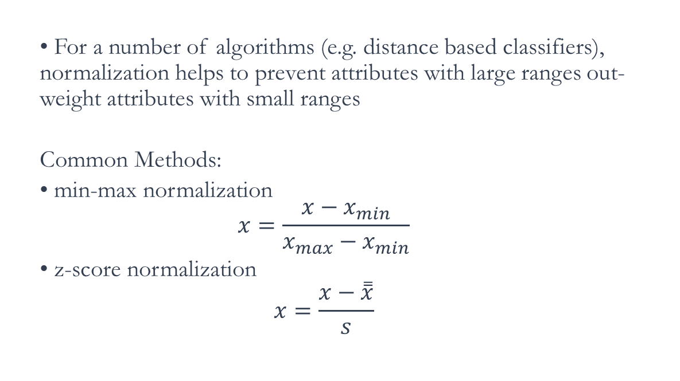
Data Transformation: Normalization
• For a number of algorithms (e.g. distance based classifiers), normalization helps to prevent attributes with large ranges out-weight attributes with small ranges
Common Methods:
• min-max normalization
$$x=\frac{x−x_{min}}{x_{max}−x_{min}}$$
• z-score normalization
$$x=\frac{x−\overset{̿}{x}}{s}$$
Notes:
One important example is normalization, or standardization, whereby values are adjusted for differing level and spread. In general the normalized values can be calculated by subtracting a given level from the original values and dividing the results by some measures of spread. In case of the min-max normalization, the values are deducted from the mean and then the product will be devided by the range of the values. As such the normalized values lies between 0 and 1 where 0. Alternatively, the z-score measures how many standard deviation any data point is far from the mean of the observations. Z-score values will have a mean of 0.

Slide 5
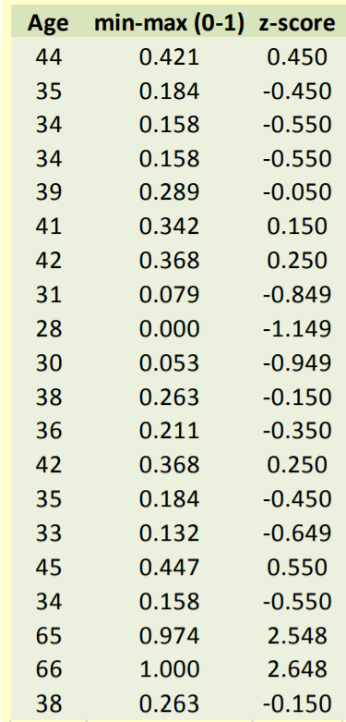
Normalization Example
Notes:
Let’s have a look at an example here. The left column shows the age values. The middle column represent the min-max transformation of the age where all values are between 0 and 1 where the minimum age that is 28 is mapped to 0 and the maximum value of age that is 66 is mapped to 1. The Table also show z-scores where the mean of the z-scores are 0 and values greater than the average of the age are mapped to positive values.

Slide 6
Data Transformation: Normalization
The preProcess ( ) function that in the ‘caret’ package is a powerful method which has implemented a number of data processing and transformation methods.
The function implements min-max normalization using “range” as the method or z-score scaling when using “center” and “scale” as input method parameters.
The function, however, creates a model which needs to be applied to the data using the predict ( ) function.
Notes:
The preProcess class can be used for many operations on predictors, including centering and scaling. The function preProcess estimates the required parameters for each operation and predict.preProcessis used to apply them to specific data sets. The function implements min-max normalization using “range” as the method or z-score scaling when using “center” and “scale” as input method parameters.

Slide 7
Example: Data Normalization
library(caret) summary(cars) ## speed dist ## Min. : 4.0 Min. : 2.00 ## 1st Qu.:12.0 1st Qu.: 26.00 ## Median :15.0 Median : 36.00 ## Mean :15.4 Mean : 42.98 ## 3rd Qu.:19.0 3rd Qu.: 56.00 ## Max. :25.0 Max. :120.00
Model_range_normalized<-preProcess(cars,method = "range") cars_normalized=predict(Model_range_normalized,cars) summary(cars_normalized) ## speed dist ## Min. :0.0000 Min. :0.0000 ## 1st Qu.:0.3810 1st Qu.:0.2034 ## Median :0.5238 Median :0.2881 ## Mean :0.5429 Mean :0.3473 ## 3rd Qu.:0.7143 3rd Qu.:0.4576 ## Max. :1.0000 Max. :1.0000
Notes:
Let’s look at an example here. Here we consider the cars data frame which gives speed of the cars and distance that takes for the car to stop. The first summary function show the distribution and range of the original values. We have then used the preprocess( ) function of the caret package with the method set to ‘range’ to create a model for min-max normalization of the variables of the cars dataset. The model was then applied to the cars dataframe using the predict function. The results are store in a new data frame called cars_normalized and the summary of the results are shown. As it can be seen both variables now are in the range 0 to 1.

Slide 8
Example: Data Normalization
Model_z_normalized<-preProcess(cars,method = c("center","scale")) summary(predict(Model_z_normalized,cars))
## speed dist ## Min. :-2.15597 Min. :-1.5903 ## 1st Qu.:-0.64301 1st Qu.:-0.6589 ## Median :-0.07565 Median :-0.2709 ## Mean : 0.00000 Mean : 0.0000 ## 3rd Qu.: 0.68083 3rd Qu.: 0.5053 ## Max. : 1.81555 Max. : 2.9888
Notes:
Alternatively, we can set the function to center and scale to compute the z-scores. In this example, we can see that the mean of both variables are set to zero after the transformation. Note that for normalization, the input dataframe to the preprocess() function should only contains numeric variables.

Slide 9
Log Transform
It might also be beneficial to apply other transformation such as logarithmic transform to reduce the skewness of the data.
This is a common practice for monetary values, for example which normally tend to have a long-tail distribution .
You should make sure that all values are positive and greater than zero in the original variable to avoid invalid results.
A fixed positive constant is normally added beforehand to avoid such scenarios.
Notes:
Log Transform can be used to reduce skewness of data. A distribution that is symmetric or nearly so is often easier to handle and interpret than a skewed distribution. More specifically, a normal or Gaussian distribution is often regarded as ideal as it is assumed by many statistical methods. The input to the logarithm function should be greater than zero, therefore in some cases it might be needed to add a constant to the values to ensure that all values are positive before applying the log transform.

Slide 10
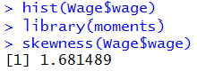

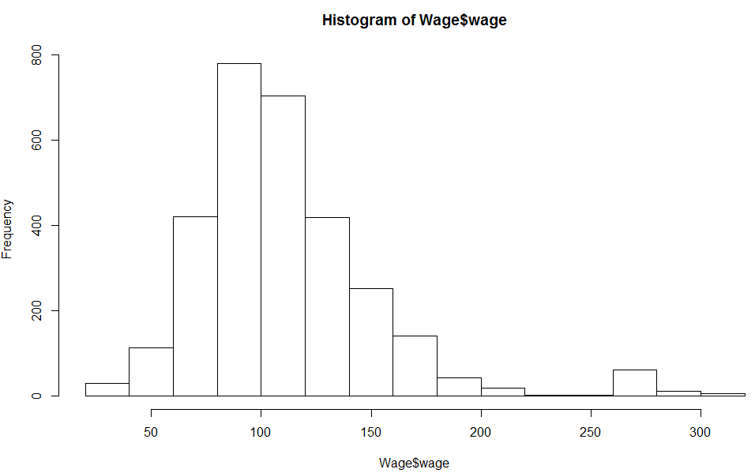
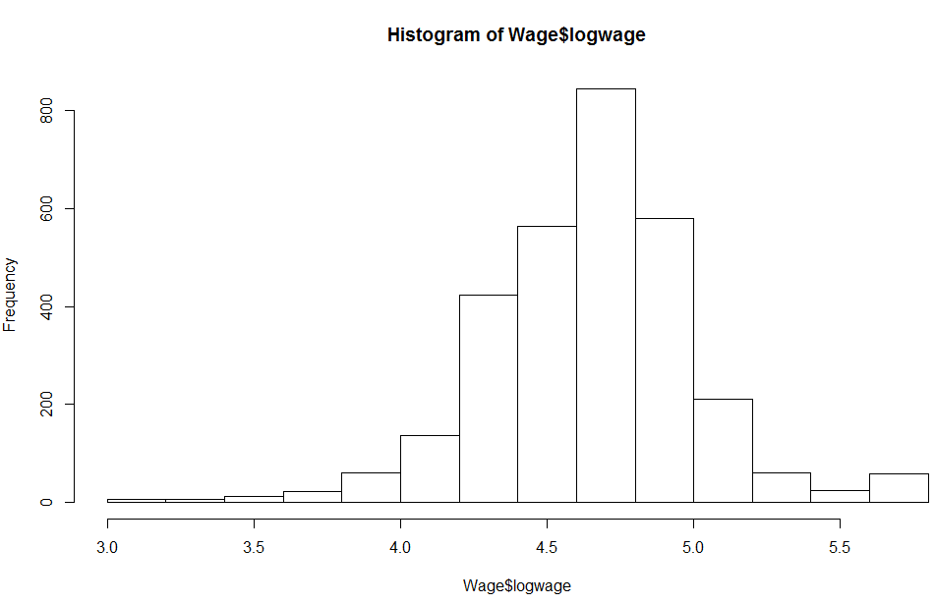
Example From The Previous Lecture
Notes:
Lets have a look at an example here using the Wage dataset from the ISLR package. Here, on the left hand side the histogram of the wage variable of the Wage dataframe is presented. The values are shown to be right skewed. This can be also confirmed by looking at the skewness coefficient which is 1.68. On the right hand side, the frequency distribution of the logarithm transform of the same variable is shown which is much more symmetric and the skewness coefficient is close to 0.

Slide 11
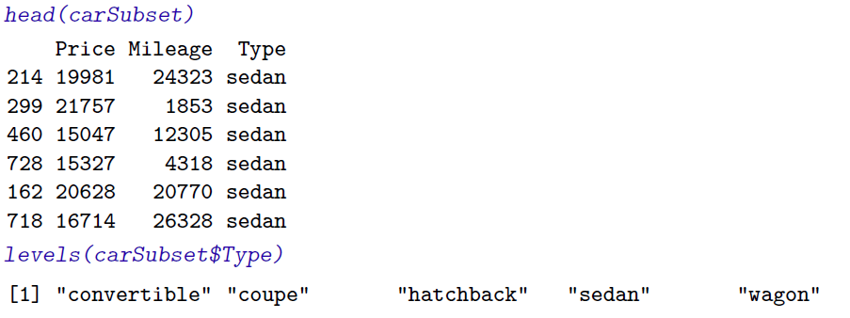
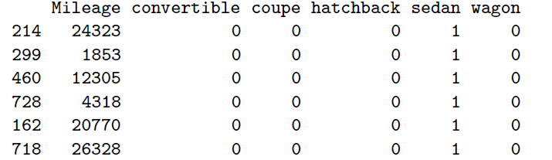
Dummy Variables
Dummy variables are artificially defined variables designed to convert a categorical variables with multiple levels into individual binary variables.
Original Data
Data with Dummy Variable
Notes:
A dummy variable (also known as an indicator variable, design variable or Boolean indicator) is one that takes the value 0 or 1 to indicate the absence or presence of some levels of a categorical variable. In other words, Dummy variables can be seen as "proxy" variables or numeric stand-ins for categorical variables. An example is shown here where the variable ‘Type’ represents the type of cars. The possible levels for this categorical variable are “convertible”, ”coupe”, ”hatchback”, “sedan” and “wagon”. When, the variable is converted to a series of dummy indicators, we will have one column for each levels of the “Type” variable where the corresponding column is True or set to 1 for each record and the rest are False or set to zero.

Slide 12
Dummy Variables
library(caret) #install if you need
library(ISLR)
dummy_model<-dummyVars(~race, data=Wage) head(predict(dummy_model,Wage))
## race.1. White race.2. Black race.3. Asian race.4. Other ## 231655 1 0 0 0 ## 86582 1 0 0 0 ## 161300 1 0 0 0 ## 155159 0 0 1 0 ## 11443 1 0 0 0 ## 376662 1 0 0 0
Notes:
Here is how we can convert categorical variables into dummy variables. We use the dummyVars() function that is part of the caret package. The Tilde symbol is used to define the R formula which defines which variables we are interested in. In this case we want to convert the race variable into dummy indicators. The function returns a model that can be applied to the data frame using the predict function. We use the head function to print the first six rows of the results. As we can see, a binary column is created for each level of the race in the Wage dataset.

